Slide 1
Computer Security: Principles and Practice
Chapter 6: Malicious Software
Notes:
Lecture slides prepared by Dr Lawrie Brown (UNSW@ADFA) for “Computer Security: Principles and Practice”, 1/e, by William Stallings and Lawrie Brown, Chapter 1 “Overview”.

Slide 2
Malware
“A program that is inserted into a system, usually covertly, with the intent of compromising the confidentiality, integrity, or availability of the victim’s data, applications, or operating system or otherwise annoying or disrupting the victim.”
Affecting CIA

Slide 3
Malicious software
Programs exploiting system vulnerabilities
Known as malicious software or malware
program fragments that need a host program
e.g. viruses, logic bombs, and backdoors
independent self-contained programs
e.g. worms, bots
replicating or not
Sophisticated threat to computer systems
Notes:
Perhaps the most sophisticated types of threats to computer systems are presented by programs that exploit vulnerabilities in computing systems. Such threats are referred to as malicious software, or malware. In this context, we are concerned with application programs as well as utility programs, such as editors and compilers, and kernel-level programs. This chapter examines malicious software, with a special emphasis on viruses and worms. The chapter begins with a survey of various types of malware, with a more detailed look at the nature of viruses and worms. We then turn to bots and rootkits. Throughout, the discussion presents both threats and countermeasures.
Malicious software can be divided into two categories: those that need a host program, and those that are independent. The former are essentially fragments of programs that cannot exist independently of some actual application program, utility, or system program. Viruses, logic bombs, and backdoors are examples. The latter are self-contained programs that can be scheduled and run by the operating system. Worms and bot programs are examples.
We can also differentiate between those software threats that do not replicate and those that do. The former are programs or fragments of programs that are activated by a trigger. Examples are logic bombs, backdoors, and bot programs. The latter consist of either a program fragment or an independent program that, when executed, may produce one or more copies of itself to be activated later on the same system or some other system. Viruses and worms are examples.

Slide 4
Malware Terminology
Virus: attaches itself to a program
Worm: propagates copies of itself to other computers
Logic bomb: “explodes” when a condition occurs
Trojan horse: fakes/contains additional functionality
Backdoor (trapdoor): allows unauthorized access to functionality
Mobile code: moves unchanged to heterogeneous platforms
Auto-rooter Kit (virus generator): malicious code (virus) generators
Spammer and flooder programs: large volume of unwanted “pkts”
Keyloggers: capture keystrokes
Rootkit: sophisticated hacker tools to gain root-level access
Zombie: software on infected computers that launch attack on others (aka bot)
Notes:
The terminology in this area presents problems because of a lack of universal agreement on all of the terms and because some of the categories overlap. Table 7.1 from the text, based on [SZOR05], is a useful guide.
Name Description
Virus attaches itself to a program and propagates copies of itself to other programs
Worm program that propagates copies of itself to other computers
Logic bomb triggers action when condition occurs
Trojan horse program that contains unexpected additional functionality
Backdoor program modification that allows unauthorized access to functionality
Mobile code software that can be shipped unchanged to a heterogeneous collection of platforms and execute with identical semantics
Auto-rooter malicious hacker tools used to break into new machines remotely Kit (virus generator) Set of tools for generating new viruses automatically
Spammer and Flooder programs are used to send large volumes of unwanted e-mail, or to attack systems with a large volumes of traffic to carry out a DoS attack
Keyloggers captures keystrokes on a compromised system
Rootkit set of hacker tools used after attacker has broken into a computer system and gained root-level access
Zombie program on infected machine activated to launch attacks on other machines

Slide 5
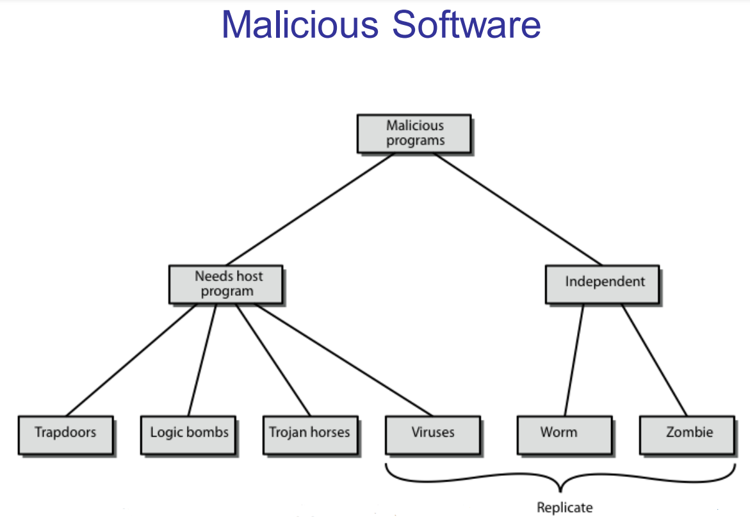

Slide 6
Some terms
Payload: actions of the malware
Crimeware: kits for building malware; include propagation and payload mechanisms
Zeus, Sakura, Blackhole, Phoenix
APT (advanced persistent threats)
Advanced: sophisticated
Persistent: attack over an extended period of time
Threat: selected targets (capable, well-funded attackers)

Slide 7
Viruses
Piece of software that infects programs
modifying them to include a copy of the virus
so it executes secretly when host program is run
Specific to operating system and hardware
taking advantage of their details and weaknesses
A typical virus goes through phases of:
dormant: idle
propagation: copies itself to other program
triggering: activated to perform functions
execution: the function is performed
Notes:
A virus is a piece of software that can "infect" other programs by modifying them; the modification includes a copy of the virus program, which can then go on to infect other programs. A virus can do anything that other programs do. The difference is that a virus attaches itself to another program and executes secretly when the host program is run. Once a virus is executing, it can perform any function, such as erasing files and programs. Most viruses carry out their work in a manner that is specific to a particular operating system and, in some cases, specific to a particular hardware platform. Thus, they are designed to take advantage of the details and weaknesses of particular systems. During its lifetime, a typical virus goes through the following four phases:
• Dormant phase: The virus is idle. The virus will eventually be activated by some event, such as a date, the presence of another program or file, or the capacity of the disk exceeding some limit. Not all viruses have this stage.
• Propagation phase: The virus places an identical copy of itself into other programs or into certain system areas on the disk. Each infected program will now contain a clone of the virus, which will itself enter a propagation phase.
• Triggering phase: The virus is activated to perform the function for which it was intended. As with the dormant phase, the triggering phase can be caused by a variety of system events, including a count of the number of times that this copy of the virus has made copies of itself.
• Execution phase: The function is performed, which may be harmless, e.g. a message on the screen, or damaging, e.g. the destruction of programs and data files

Slide 8
Virus structure
Components:
infection mechanism: enables replication
trigger: event that makes payload activate
payload: what it does, malicious or benign
Prepended/postpended/embedded
When infected program invoked, executes virus code then original program code
Can block initial infection (difficult) or propagation (with access controls)
Notes:
A computer virus has three parts [AYCO06]:
• Infection mechanism:The means by which a virus spreads, enabling it to replicate. The mechanism is also referred to as the infection vector.
• Trigger: event or condition determining when the payload is activated or delivered.
• Payload: What the virus does, besides spreading. The payload may involve damage or may involve benign but noticeable activity.
A virus can be prepended or postpended to an executable program, or it can be embedded in some other fashion. The key to its operation is that the infected program, when invoked, will first execute the virus code and then execute the original code of the program.
Once a virus has gained entry to a system by infecting a single program, it is in a position to infect some or all other executable files on that system when the infected program executes. Thus, viral infection can be completely prevented by preventing the virus from gaining entry in the first place. Unfortunately, prevention is extraordinarily difficult because a virus can be part of any program outside a system. Thus, unless one is content to take an absolutely bare piece of iron and write all one's own system and application programs, one is vulnerable. The lack of access controls on early PCs is a key reason why traditional machine code based viruses spread rapidly on these systems. In contrast, while it is easy enough to write a machine code virus for UNIX systems, they were almost never seen in practice due to the existence of access controls on these systems prevented effective propagation of the virus.

Slide 9
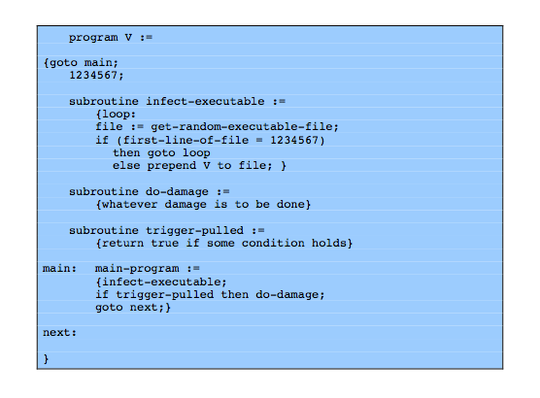
Virus structure
Notes:
A very general depiction of virus structure is shown in Figure 7.1 (based on [COHE94]). In this case, the virus code, V, is prepended to infected programs, and it is assumed that the entry point to the program, when invoked, is the first line of the program. An infected program begins with the virus code and works as follows. The first line of code is a jump to the main virus program. The second line is a special marker that is used by the virus to determine whether or not a potential victim program has already been infected with this virus. When the program is invoked, control is immediately transferred to the main virus program. The virus program first seeks out uninfected executable files and infects them. Next, the virus may perform some action, usually detrimental to the system. This action could be performed every time the program is invoked, or it could be a logic bomb that triggers only under certain conditions. Finally, the virus transfers control to the original program. If the infection phase of the program is reasonably rapid, a user is unlikely to notice any difference between the execution of an infected and uninfected program.

Slide 10
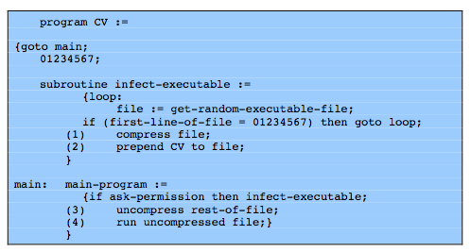
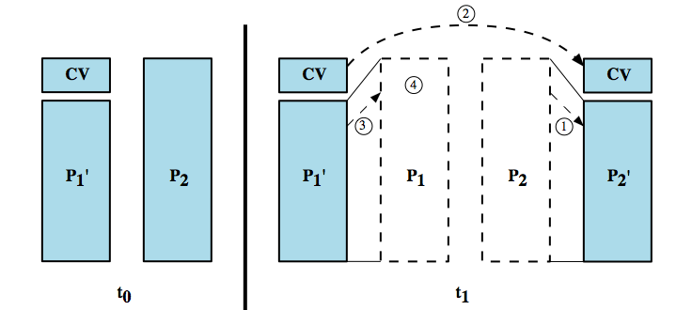
Compression virus
P1 is infected
Notes:
A virus such as the one just described is easily detected because an infected version of a program is longer than the corresponding uninfected one. A way to thwart such a simple means of detecting a virus is to compress the executable file so that both the infected and uninfected versions are of identical length. The code shown from Figure 7.2 [COHE94] shows in general terms the logic required. The key lines in this virus are numbered, and Figure 7.3 at the bottom from [COHE94] illustrates the operation. In this example, the virus does nothing other than propagate. As in the previous example, the virus may include a logic bomb. We assume that program P₁ is infected with the virus CV. When this program is invoked, control passes to its virus, which performs the following steps:
1. For each uninfected file P₂ that is found, the virus first compresses that file to produce , which is shorter than the original program by the size of the virus.
2. A copy of the virus is prepended to the compressed program.
3. The compressed version of the original infected program, , is uncompressed.
4. The uncompressed original program is executed.

Slide 11
Virus classification
By target
boot sector: infect a master boot record
file infector: infects executable OS files
macro virus: infects files to be used by an app
multipartite: infects multiple ways
By concealment
encrypted virus: encrypted; key stored in virus
stealth virus: hides itself (e.g., compression)
polymorphic virus: recreates with diff “signature”
metamorphic virus: recreates with diff signature and behavior
Notes:
There has been a continuous arms race between virus writers and writers of antivirus software since viruses first appeared. As effective countermeasures have been developed for existing types of viruses, new types have been developed. A virus classification by target includes the following categories:
• Boot sector infector:Infects a master boot record or boot record and spreads when a system is booted from the disk containing the virus.
• File infector: Infects files that the operating system or shell consider to be executable.
• Macro virus: Infects files with macro code that is interpreted by an application.
A virus classification by concealment strategy includes the following categories:
• Encrypted virus: the virus creates a random encryption key, stored with the virus, and encrypts the remainder of the virus. When an infected program is invoked, the virus uses the stored random key to decrypt the virus. When the virus replicates, a different random key is selected.
• Stealth virus: A form of virus explicitly designed to hide itself from detection by antivirus software. Thus,the entire virus, not just a payload is hidden.
• Polymorphic virus: A virus that mutates with every infection, making detection by the “signature”of the virus impossible.
• Metamorphic virus: As with a polymorphic virus ,a metamorphic virus mutates with every infection. The difference is that a metamorphic virus rewrites itself completely at each iteration, increasing the difficulty of detection. Metamorphic viruses may change their behavior as well as their appearance.

Slide 12
Macro and scripting viruses
Became very common in mid-1990s since
platform independent
infect documents
easily spread
Exploit macro capability of Office apps
executable program embedded in office doc
often a form of Basic
More recent releases include protection
Recognized by many anti-virus programs
Notes:
In the mid-1990s, macro viruses became by far the most prevalent type of virus. Macro viruses are particularly threatening for a number of reasons:
1. A macro virus is platform independent. Virtually all of the macro viruses infect Microsoft Word documents. Any hardware platform and operating system that supports Word can be infected.
2. Macro viruses infect documents, not executable portions of code. Most of the information introduced onto a computer system is in the form of a document rather than a program.
3. Macro viruses are easily spread. A very common method is by electronic mail.
Macro viruses take advantage of a feature found in Word and other office applications such as Microsoft Excel, namely the macro. In essence, a macro is an executable program embedded in a word processing document or other type of file. Typically, users employ macros to automate repetitive tasks and thereby save keystrokes. The macro language is usually some form of the Basic programming language. A user might define a sequence of keystrokes in a macro and set it up so that the macro is invoked when a function key or special short combination of keys is input. Successive releases of Word provide increased protection against macro viruses. For example, Microsoft offers an optional Macro Virus Protection tool that detects suspicious Word files and alerts the customer to the potential risk of opening a file with macros. Various antivirus (A/V) product vendors have also developed tools to detect and correct macro viruses. As in other types of viruses, the arms race continues in the field of macro viruses, but they no longer are the predominant virus threat.

Slide 13
E-Mail Viruses
More recent development
Melissa
exploits MS Word macro in attached doc
if attachment opened, macro activates
sends email to all on users address list and does local damage
Notes:
A more recent development in malicious software is the e-mail virus. The first rapidly spreading e-mail viruses, such as Melissa, made use of a Microsoft Word macro embedded in an attachment. If the recipient opens the e-mail attachment, the Word macro is activated. Then the e-mail virus sends itself to everyone on the mailing list in the user's e-mail package, and also does local damage.
At the end of 1999, a more powerful version of the e-mail virus appeared. This newer version can be activated merely by opening an e-mail that contains the virus rather than opening an attachment. The virus uses the Visual Basic scripting language supported by the e-mail package.
Thus we see a new generation of malware that arrives via e-mail and uses e-mail software features to replicate itself across the Internet. The virus propagates itself as soon as activated (either by opening an e-mail attachment of by opening the e-mail) to all of the e-mail addresses known to the infected host. As a result, whereas viruses used to take months or years to propagate, they now do so in hours. This makes it very difficult for antivirus software to respond before much damage is done. Ultimately, a greater degree of security must be built into Internet utility and application software on PCs to counter the growing threat.

Slide 14
Virus countermeasures
Prevention: ideal solution but difficult
Realistically need:
detection: determine what occurred
identification: identify the specific virus
removal: remove all traces
If detected but can’t identify or remove, must discard and replace infected program
Notes:
The ideal solution to the threat of viruses is prevention: Do not allow a virus to get into the system in the first place. This goal is, in general, impossible to achieve, although prevention can reduce the number of successful viral attacks. The next best approach is to be able to do the following:
• Detection: Once the infection has occurred, determine that it has occurred and locate the virus.
• Identification: Once detection has been achieved, identify the specific virus that has infected a program.
• Removal: Once the specific virus has been identified, remove all traces of the virus from the infected program and restore it to its original state. Remove the virus from all infected systems so that the disease cannot spread further.
If detection succeeds but either identification or removal is not possible, then the alternative is to discard the infected program and reload a clean backup version.

Slide 15
Anti-virus evolution
Virus & antivirus tech have both evolved
Early viruses simple code, easily removed
As viruses become more complex, so did the countermeasures
Generations
first - signature scanners (bit patterns all the same)
second – heuristics (integrity checks; checksums)
third - identify actions (find by actions they do)
fourth - combination packages
Notes:
Advances in virus and antivirus technology go hand in hand. Early viruses were relatively simple code fragments and could be identified and purged with relatively simple antivirus software packages. As the virus arms race has evolved, both viruses and, necessarily, antivirus software have grown more complex and sophisticated. [STEP93] identifies four generations of antivirus software:
A first-generation scanner requires a virus signature to identify a virus. The virus may contain "wildcards" but has essentially the same structure and bit pattern in all copies. Such signature-specific scanners are limited to the detection of known viruses.
A second-generation scanner uses heuristic rules to search for probable virus infection, e.g to look for fragments of code that are often associated with viruses.. Another second-generation approach is integrity checking, using a hash function rather than a simpler checksum.
Third-generation programs are memory-resident programs that identify a virus by its actions rather than structure in an infected program. These have the advantage that it is not necessary to develop signatures / heuristics, but only to identify the small set of actions indicating an infection is attempted and then intervene.
Fourth-generation products are packages consisting of a variety of antivirus techniques used in conjunction. These include scanning and activity trap components. In addition, such a package includes access control capability, which limits the ability of viruses to penetrate a system and then limits the ability of a virus to update files in order to pass on the infection.

Slide 16
Generic decryption
Runs executable files through GD scanner:
CPU emulator to interpret instructions
virus scanner to check known virus signatures
emulation control module to manage process
Lets virus decrypt itself in interpreter
Periodically scan for virus signatures
Let virus do the work for an antivirus program by exposing it in a controlled environment
Notes:
More sophisticated antivirus approaches and products continue to appear. In this subsection, we highlight some of the most important.
Generic decryption (GD) technology enables the antivirus program to easily detect even the most complex polymorphic viruses, while maintaining fast scanning speeds. In order to detect encrypted viruses, executable files are run through a GD scanner:
• CPU emulator: A software-based virtual computer that interprets instructions in an executable file rather than executing them on the underlying processor.
• Virus signature scanner: scans the target code looking for known virus signatures.
• Emulation control module: Controls the execution of the target code.
At the start of each simulation, the emulator begins interpreting instructions in the target code, one at a time. Thus, if the code includes a decryption routine that decrypts and hence exposes the virus, that code is interpreted. In effect, the virus does the work for the antivirus program by exposing the virus. Periodically, the control module interrupts interpretation to scan the target code for virus signatures. During interpretation, the target code can cause no damage to the actual personal computer environment, because it is being interpreted in a completely controlled environment. The most difficult design issue with a GD scanner is to determine how long to run each interpretation. Typically, virus elements are activated soon after a program begins executing, but this need not be the case. The longer the scanner emulates a particular program, the more likely it is to catch any hidden viruses. However, the antivirus program can take up only a limited amount of time and resources before users complain.

Slide 17
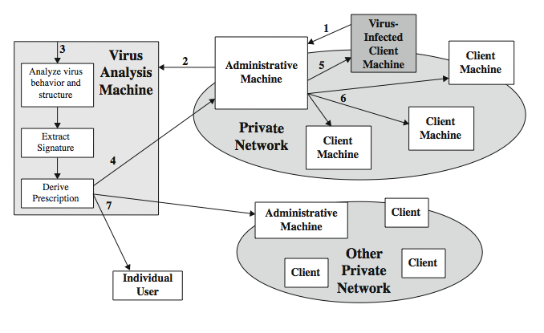
Digital immune system
A monitoring pgm infers a virus, sends a copy to an adm machine
Adm encrypts, sends to a central analysis machine
Central analysis: Safe exec of virus, analyze, give a prescription
Prescription sent back to the adm machines
Adm machine forwards to all clients
Prescription forwarded to other organizations
Subscribers worldwide receive regular updates IBM/Symantec Project
Notes:
The digital immune system is a comprehensive approach to virus protection developed by IBM and subsequently refined by Symantec. The objective of this system is to provide rapid response time so that viruses can be stamped out almost as soon as they are introduced. When a new virus enters an organization, the immune system automatically captures it, analyzes it, adds detection and shielding for it, removes it, and passes information about that virus to other systems so that it can be detected before it is allowed to run elsewhere, as Figure 7.4 illustrates:
1. A monitoring program on each PC uses a variety of heuristics to infer that a virus may be present, and forwards a copy to an administrative machine.
2. The admin machine encrypts this and sends it to a central virus analysis machine.
3. This machine creates an environment in which the infected program can be safely run for analysis. The virus analysis machine then produces a prescription for identifying and removing the virus.
4. The resulting prescription is sent back to the administrative machine.
5. The administrative machine forwards the prescription to the infected client.
6. The prescription is also forwarded to other clients in the organization.
7. Subscribers worldwide receive regular antivirus updates to protect from new virus
The success of the digital immune system depends on the ability of the virus analysis machine to detect new and innovative virus strains. By constantly analyzing and monitoring the viruses found in the wild, it should be possible to continually update the digital immune software to keep up with the threat.

Slide 18
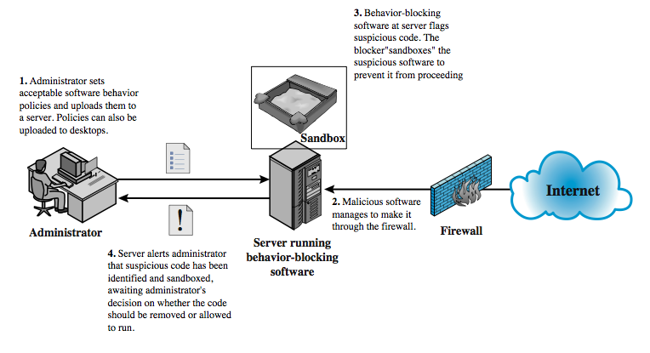
Behavior-blocking software Integrates with the OS; looks for bad behavior
Monitored behaviors:
Attempts to open, view, delete, modify files
Attempts to format drives
Modifications to the logic of executables
Modifications to critical system settings
Scripting of emails to send exec contents
Notes:
Unlike heuristics or fingerprint-based scanners, behavior-blocking software integrates with the operating system of a host computer and monitors program behavior in real-time for malicious actions. The behavior blocking software then blocks potentially malicious actions before they can affect the system. Monitored behaviors can include
• Attempts to open, view, delete, and/or modify files;
• Attempts to format disk drives and other unrecoverable disk operations;
• Modifications to the logic of executable files or macros;
• Modification of critical system settings, such as start-up settings;
• Scripting of e-mail and instant messaging clients to send executable content; and
• Initiation of network communications.
Figure 7.5 illustrates its operation. Behavior-blocking software runs on server and desktop computers and is instructed through policies set by the network administrator to let benign actions take place but to intercede when unauthorized or suspicious actions occur. The module blocks any suspicious software from executing. A blocker isolates the code in a sandbox, which restricts the code's access to various OS resources and applications. The blocker then sends an alert. Because behavior blocker can block suspicious software in real-time, it has an advantage over such established antivirus detection techniques as fingerprinting or heuristics. Behavior blocking alone has limitations. Because the malicious code must run on the target machine before all its behaviors can be identified, it can cause harm before it has been detected and blocked.

Slide 19
Worms
Replicating program that propagates over net
using email, remote exec, remote login
Has phases like a virus:
dormant, propagation, triggering, execution
propagation phase: searches for other systems, connects to it, copies self to it and runs
May disguise itself as a system process
Concept seen in Brunner’s “Shockwave Rider”
Implemented by Xerox Palo Alto labs in 1980’s
Notes:
A worm is a program that can replicate itself and send copies from computer to computer across network connections. Upon arrival, the worm may be activated to replicate and propagate again. In addition to propagation, the worm usually performs some unwanted function. Network worm programs use network connections to spread from system to system. Once active within a system, a network worm can behave as a computer virus or bacteria, or it could implant Trojan horse programs or perform any number of disruptive or destructive actions. To replicate itself, a network worm uses some sort of network vehicle such as email, remote execution or remote login capabilities. The new copy of the worm program is then run on the remote system where, in addition to any functions that it performs at that system, it continues to spread in the same fashion. A network worm exhibits the same characteristics as a computer virus: a dormant phase, a propagation phase, a triggering phase, and an execution phase. The propagation phase generally: searches for other systems to infect by examining host tables or similar repositories of remote system addresses; establishes a connection with a remote system; and copies itself to the remote system and cause the copy to be run. The network worm may also attempt to determine whether a system has previously been infected before copying itself to the system. In a multiprogramming system, it may also disguise its presence by naming itself as a system process or using some other name that may not be noticed by a system operator. The concept of a computer worm was introduced in John Brunner’s 1975 SF novel “The Shockwave Rider”. The first known worm implementation was done in Xerox Palo Alto Labs in the early 1980s. It was a nonmalicious search for idle systems to use to run a computationally intensive task. As with viruses, network worms are difficult to counter.

Slide 20
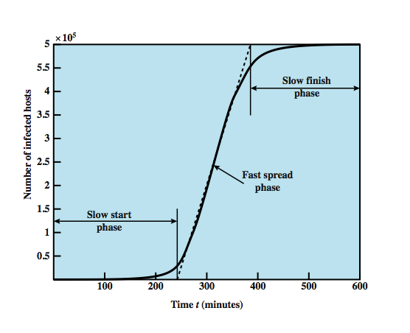
Worm Propagation Model (based on recent attacks)
linear rate of infection
exponential rate of infection
Notes:
[ZOU05] describes a model for worm propagation based on an analysis of recent worm attacks. The speed of propagation and the total number of hosts infected depend on a number of factors, including the mode of propagation, the vulnerability or vulnerabilities exploited, and the degree of similarity to preceding attacks. For the latter factor, a an attack that is a variation on a recent previous attack may be countered more effectively than a more novel attack. Figure 7.6 shows the dynamics for one, typical, set of parameters. Propagation proceeds through three phases. In the initial phase, the number of hosts increases exponentially. To see that this is so, consider a simplified case in which a worm is launched from a single host and infects two nearby hosts. Each of these hosts infects two more hosts, and so on. This results in exponential growth. After a time, infecting hosts waste some time attacking already-infected hosts, which reduces the rate of infection. During this middle phase, growth is approximately linear, but the rate of infection is rapid. When most vulnerable computers have been infected, the attack enters a slow finish phase as the worm seeks out those remaining hosts that are difficult to identify. Clearly, the objective in countering a worm is to catch the worm in its slow start phase, at a time when few hosts have been infected.

Slide 21
State of worm technology
Multiplatform: not limited to Windows
Multi-exploit: Web servers, emails, file sharing …
Ultrafast spreading: do a scan to find vulnerable hosts
Polymorphic: each copy has a new code
Metamorphic: change appearance/behavior
Transport vehicles (e.g., for DDoS)
Zero-day exploit of unknown vulnerability (to achieve max surprise/distribution)
Notes:
The state of the art in worm technology includes the following:
• Multiplatform: Newer worms are not limited to Windows machines but can attack a variety of platforms, especially the popular varieties of UNIX.
• Multi-exploit: New worms penetrate systems in a variety of ways, using exploits against Web servers, browsers, e-mail, file sharing, and other network-based applications.
• Ultrafast spreading: One technique to accelerate the spread of a worm is to conduct a prior Internet scan to accumulate Internet addresses of vulnerable machines.
• Polymorphic: To evade detection, skip past filters, and foil real-time analysis, worms adopt the virus polymorphic technique. Each copy of the worm has new code generated on the fly using functionally equivalent instructions and encryption techniques.
• Metamorphic: In addition to changing their appearance, metamorphic worms have a repertoire of behavior patterns that are unleashed at different stages of propagation.
• Transport vehicles: Because worms can rapidly compromise a large number of systems, they are ideal for spreading other distributed attack tools, such as distributed denial of service bots.
• Zero-day exploit: To achieve maximum surprise and distribution, a worm should exploit an unknown vulnerability that is only discovered by the general network community when the worm is launched.

Slide 22
Worm countermeasures
Overlaps with anti-virus techniques
Once worm on system A/V can detect
Worms also cause significant net activity
Worm defense approaches include:
signature-based worm scan filtering: define signatures
filter-based worm containment (focus on contents)
payload-classification-based worm containment (examine packets for anomalies)
threshold random walk scan detection (limit the rate of scan-like traffic)
rate limiting and rate halting (limit outgoing traffic when a threshold is met)
Notes:
There is considerable overlap in techniques for dealing with viruses and worms. Once a worm is resident on a machine, antivirus software can be used to detect it. In addition, because worms propagation generates considerable network activity, the monitoring of that activity can lead form the basis of a worm defense. Have classes:
Signature-based worm scan filtering: generates a worm signature, which is then used to prevent worm scans from entering/leaving a network/host.
Filter-based worm containment: focuses on worm content rather than a scan signature. The filter checks a message to determine if it contains worm code.
Payload-classification-based worm containment: examine packets to see if they contain a worm using anomaly detection techniques
Threshold random walk (TRW) scan detection: exploits randomness in picking destinations to connect to as a way of detecting if a scanner is in operation
Rate limiting: limits the rate of scanlike traffic from an infected host.
Rate halting: immediately blocks outgoing traffic when a threshold is exceeded either in outgoing connection rate or diversity of connection attempts. Rate halting can integrate with a signature- or filter-based approach so that once a signature or filter is generated, every blocked host can be unblocked; as with rate limiting, rate halting techniques are not suitable for slow, stealthy worms.

Slide 23
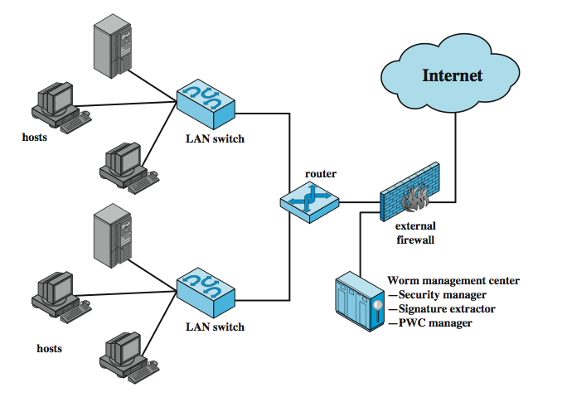
Proactive worm containment
Agent monitors
outgoing traffic for
increased activity
2. When an agent notices
high traffic, it informs
the controller; controller
propagates to other
hosts
3. Hosts receive alert
and decide if to ignore
(based on time of last
incoming pkt)
4. Relaxation period
(based on threshold)
Notes:
The Proactive Worm Containment (PWC) scheme is host based software that looks for surges in the rate of frequency of outgoing connection attempts and the diversity of connections to remote hosts. When such a surge is detected, the software immediately blocks its host from further connection attempts. A deployed PWC system consists of a PWC manager and PWC agents in hosts. Figure 7.7 from the text is an example of an architecture that includes PWC, which operates as detailed:
A PWC agent monitors outgoing traffic for scan activity, determined by a surge in UDP / TCP connection attempts to remote hosts. If a surge is detected, the agent: 1) issues an alert to local system; 2) blocks all outgoing connection attempts; 3) transmits the alert to the PWC manager; and 4) starts a relaxation analysis.
B. A PWC manager receives an alert, and propagates the alert to all other agents.
C. The host receives an alert, and must decide whether to ignore the alert. If the time since the last incoming packet has been sufficiently long so that the agent would have detected a worm if infected, then the alert is ignored. Otherwise, the agent assumes that it might be infected and performs the following actions:(1) blocks all outgoing connection attempts from the specific alerting port;and (2) starts a relaxation analysis.
D. Relaxation analysis. An agent monitors outgoing activity for a fixed window of time to see if outgoing connections exceed a threshold. If so, blockage is continued and relaxation analysis is repeated until the outgoing connection rate drops below the threshold, at which time the agent removes the block. If the threshold continues to be exceeded over a sufficient number of relaxation windows, the agent isolates the host and reports to the PWC manager.
Meanwhile, a signature extractor functions as a passive sensor that monitors all traffic and attempts to detect worms by signature analysis.

Slide 24
Mobile code
Scripts, macros or other portable instructions
Popular ones: JavaScript, ActiveX, VBScript
Heterogeneous platforms
From a remote system to a local system
Can act as an agent for viruses, works, and Trojan horses
Mobile phone works: communicate the Bluetooth connections (e.g., CommWarrior on Symbian but attempts on Android and iPhone)

Slide 25
Client-side vulnerabilities
Drive-by-downloads: common in recent attacks
Exploits browser vulnerabilities (when a user visits a website controlled by the attacker or a compromised website)
Clickjacking

Slide 26
Social engineering, spam, email, Trojans
Spam (much better protection now)
Trojan horse: looks like a useful tool but contains hidden code

Slide 27
Payload
Data destruction, theft
Data encryption (ransomware)
Real-world damage
Stuxnet: caused physical damage also (targeted to Siemens industrial control software)
Logic bomb

Slide 28
Payload attack agents: bots (zombie/drone)
Program taking over other computers and launch attacks
hard to trace attacks
If coordinated form a botnet
Characteristics:
remote control facility (distinguishing factor)
via IRC/HTTP etc
spreading mechanism
attack software, vulnerability, scanning strategy
Various counter-measures applicable (IDS, honeypots, …)
Notes:
A bot (robot), also known as a zombie or drone, is a program that secretly takes over hundreds or thousands of Internet-attached computer and then uses that computer to launch attacks that are difficult to trace to the bot's creator. The collection of bots often is capable of acting in a coordinated manner; referred to as a botnet. A botnet exhibits three characteristics: the bot functionality, a remote control facility, and a spreading mechanism to propagate the bots and construct the botnet. Some uses of bots include: distributed denial-of-service attacks, spamming, sniffing traffic, keylogging, spreading new malware, installing advertisement add-ons and browser helper objects (bhos), attacking irc chat networks, manipulating online polls/games.
The remote control facility is what distinguishes a bot from a worm. A typical means of implementing the remote control facility is on an IRC (Internet relay chat) server. More recent botnets tend to avoid IRC mechanisms and use covert communication channels via protocols such as HTTP. Once a communications path is established between a control module and the bots, the control module can activate the bots, and even issue update commands that to download a file from some Internet location and execute it, making a more general-purpose tool that can be used for multiple attacks.
The first step in a botnet attack is for the attacker to infect a number of machines with bot software that will ultimately be used to carry out the attack. The essential ingredients in this phase of the attack are: Software that can carry out the attack; A vulnerability in a large number of systems; A strategy for locating vulnerable machines, a process known as scanning.
A number of the countermeasures discussed in this and the preceding chapter make sense against bots, including IDSs, honeypots, and digital immune systems.

Slide 29
Uses of bots
DDoS
Spamming
Sniffing traffic
Keylogging
Spreading malware
Installing advertisement
Manipulating games and polls

Slide 30
Payload: information theft
Credential theft, key loggers, spyware
Phishing identify theft
Spear phishing (act as a trusted source for a specific target)

Slide 31
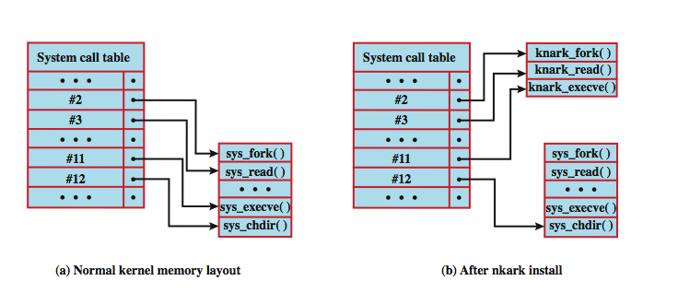
Rootkit System Table Mods A Unix Example
User API calls refer to a number; the system
maintains a system call table with one entry per number;
each number is used to index to a corresponding system routine
rootkit modifies the table and the calls go to the hackers
replacements
Notes:
Programs operating at the user level interact with the kernel through system calls. Thus, system calls are a primary target of kernel-level rootkits to achieve concealment. As an example of how rootkits operate, we look at the implementation of system calls in Linux. In Linux, each system call is assigned a unique syscall number. When a user-mode process executes a system call, the process refers to the system call by this number. The kernel maintains a system call table with one entry per system call routine; each entry contains a pointer to the corresponding routine.. The syscall number serves as an index into the system call table. [LEVI06] lists three techniques that can be used to change system calls:
• Modify the system call table: The attacker modifies selected syscall addresses stored in the system call table. This enables the rootkit to direct a system call away from the legitimate routine to the rootkit's replacement. Figure 7.8 shows how the knark rootkit achieves this.
• Modify system call table targets: The attacker overwrites selected legitimate system call routines with malicious code. The system call table is not changed.
• Redirect the system call table: The attacker redirects references to the entire system call table to a new table in a new kernel memory location.
If a kernel-level rootkit is detected, by any means, the only secure and reliable way to recover is to do an entire new OS install on the infected machine.

Slide 32
Countermeasures
Prevention
Detection, identification, removal
Requirement
generality
Timeliness
Resiliency
Minimal DoS costs
Transparency
Global/local coverage (inside and outside attackers)

Slide 33
Summary
introduced types of malicous software
incl backdoor, logic bomb, trojan horse, mobile
virus types and countermeasures
worm types and countermeasures
bots
rootkits
Notes:
Chapter 7 summary.

